Slide 1
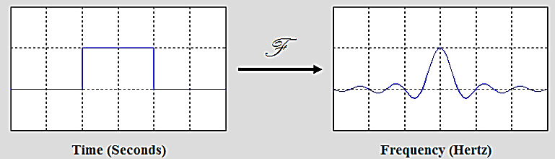

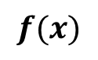
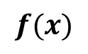
Fourier Transform
$$f(x)$$
Fourier
Transform
F(ω)
F(ω)
Inverse Fourier
Transform
$$f(x)$$

Slide 2
Book: Advanced Modern Engineering Mathematics (4th Edition) by Glyn James
Chapter: 8
Sections: 8.3
Book: Signals and Systems (2nd Edition) by Alan V. Oppenheim, Alan S. Willsky, and S. Hamid Nawab
Chapter: 4
Sections: 4.1, 4.3

Slide 3
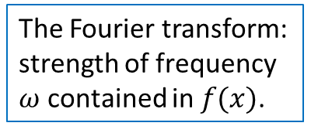
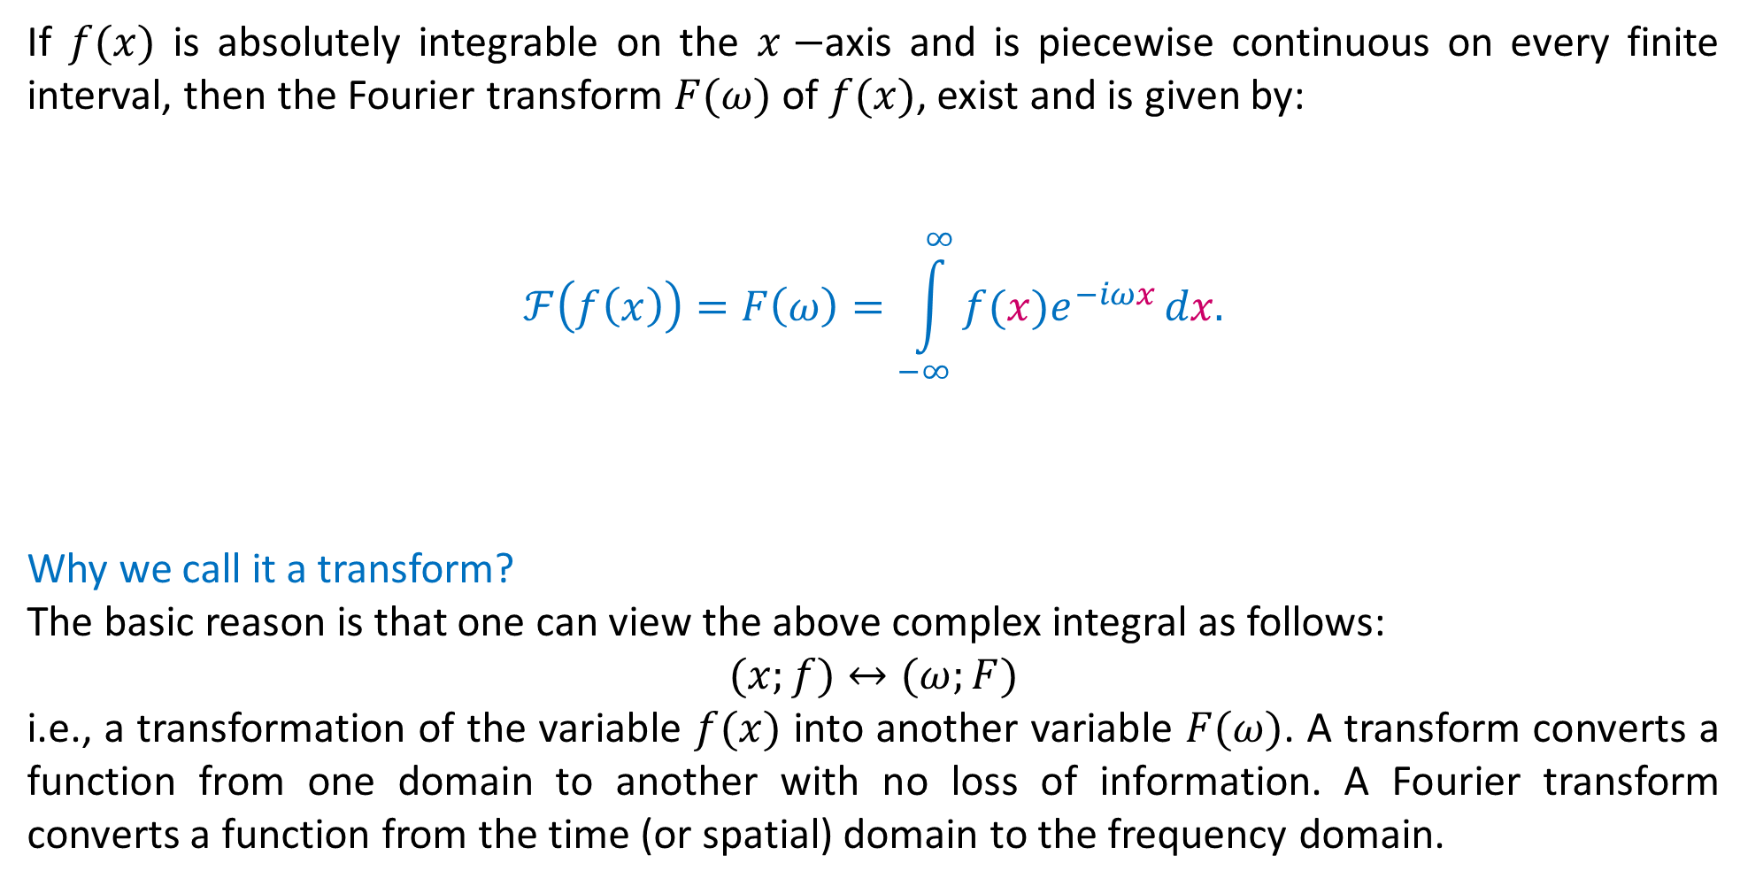
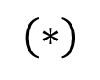
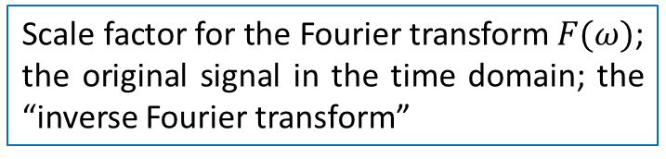
Fourier Transform: Analysis
If $f(x)$ is absolutely integrable on the $x−$axis and is piecewise continuous on every finite interval, then the Fourier transform $F(ω)$of $f(x)$, exist and is given by:
$$ℱ\left(f\left(x\right)\right)=F\left(ω\right)=\int_{−∞}^{∞}{f(x)e^{−iωx}}dx.$$
Why we call it a transform?
The basic reason is that one can view the above complex integral as follows:
$$(x;f)↔(ω;F)$$
i.e., a transformation of the variable $f(x)$ into another variable $F(ω)$. A transform converts a function from one domain to another with no loss of information. A Fourier transform converts a function from the time (or spatial) domain to the frequency domain.
Sinusoidally varying “basis” function for the expansion.
The Fourier transform: strength of frequency $ω$ contained in $f(x)$.
$$(∗)$$
Scale factor for the Fourier transform $F(ω)$; the original signal in the time domain; the “inverse Fourier transform”

Slide 4
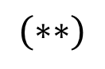
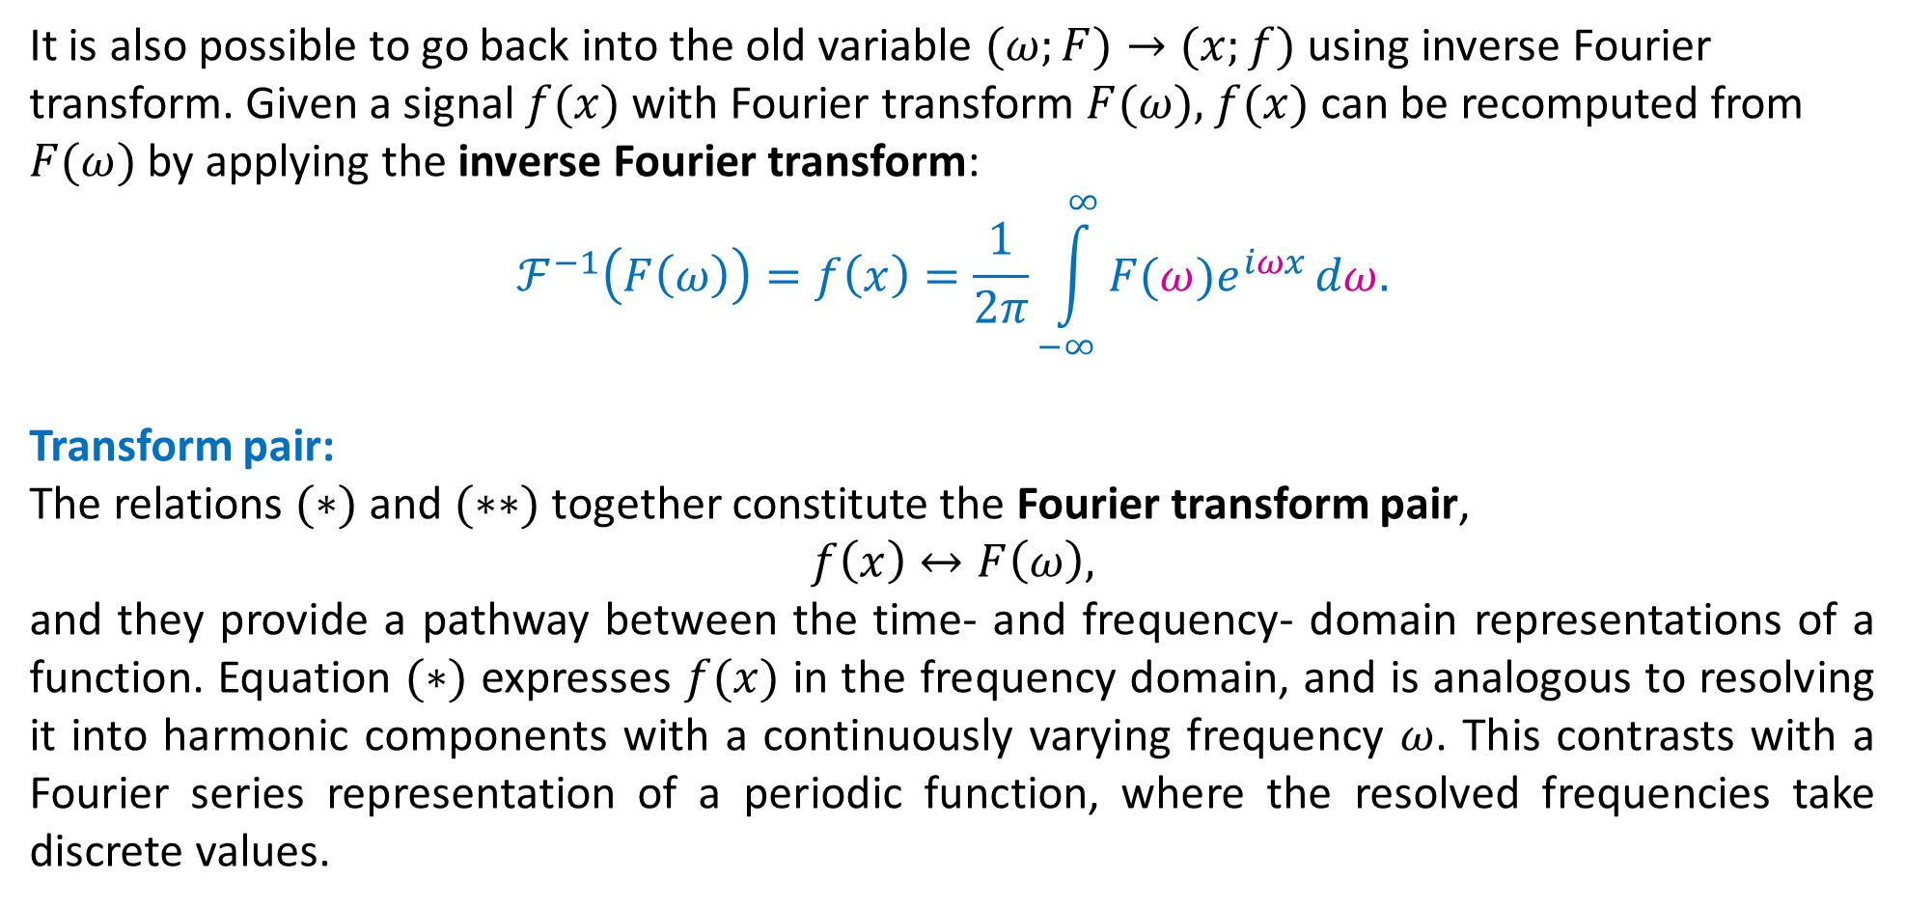
Inverse Fourier Transform: Synthesis
It is also possible to go back into the old variable $(ω;F)→(x;f)$ using inverse Fourier transform. Given a signal $f(x)$ with Fourier transform $F(ω),$ $f(x)$ can be recomputed from $F(ω)$ by applying the inverse Fourier transform:
$$ℱ^{−1}\left(F\left(ω\right)\right)=f\left(x\right)=\frac{1}{2π}\int_{−∞}^{∞}{F(ω)e^{iωx}}dω.$$
Transform pair:
The relations $(∗)$and $(∗∗)$together constitute the Fourier transform pair,
$$f\left(x\right)↔F\left(ω\right),$$
and they provide a pathway between the time- and frequency- domain representations of a function. Equation $(∗)$ expresses $f(x)$ in the frequency domain, and is analogous to resolving it into harmonic components with a continuously varying frequency $ω$. This contrasts with a Fourier series representation of a periodic function, where the resolved frequencies take discrete values.
$$(∗∗)$$

Slide 8
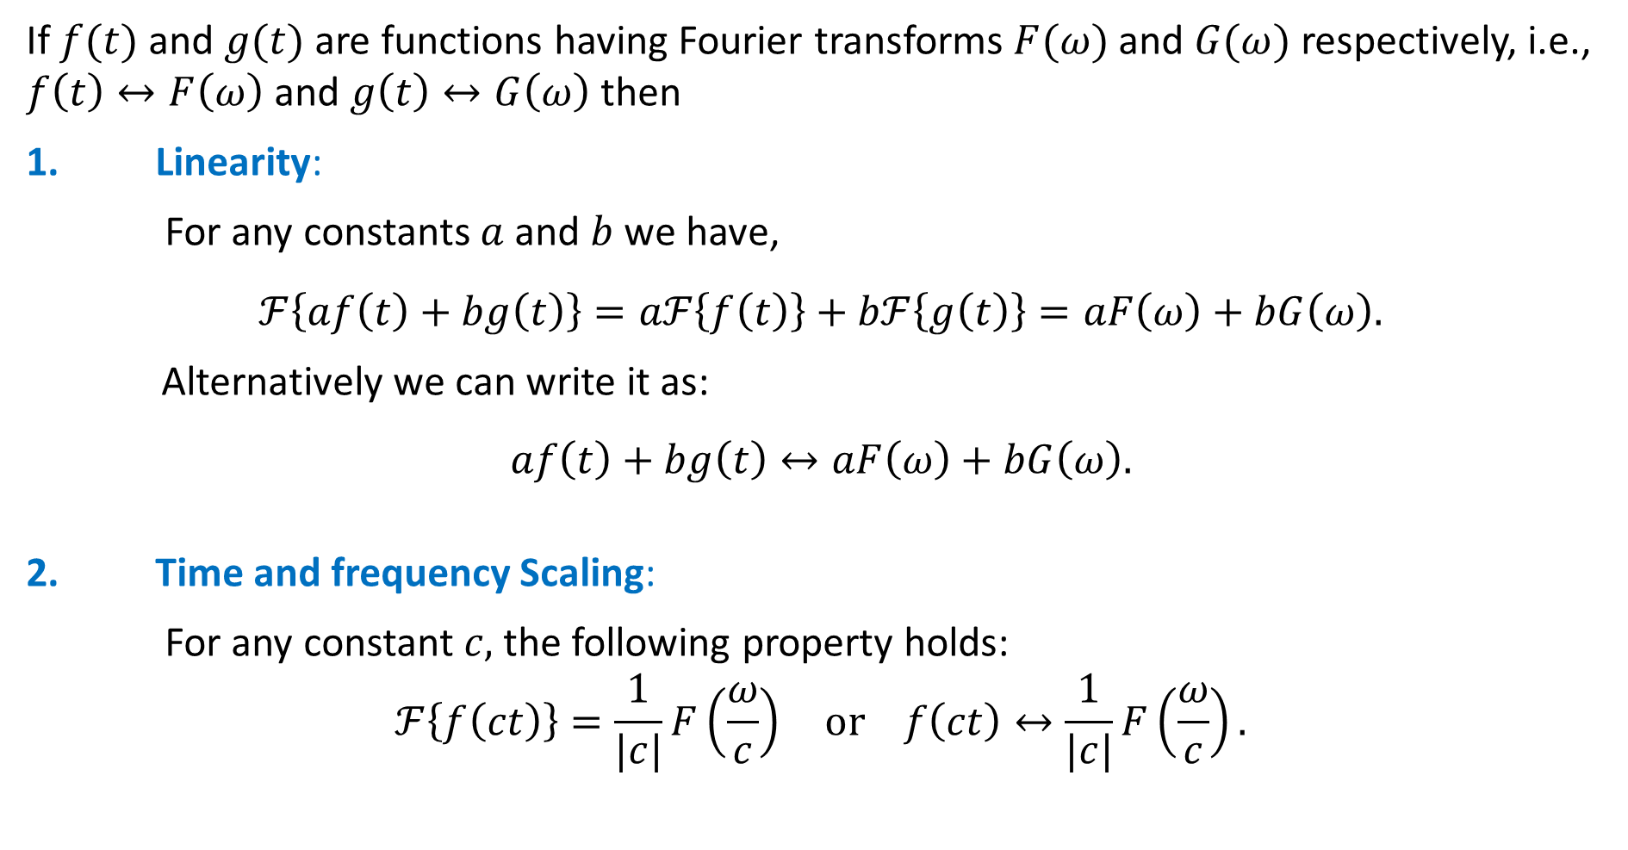
Properties of Fourier transform
If $f(t)$ and $g(t)$ are functions having Fourier transforms $F(ω)$ and $G(ω)$ respectively, i.e., $f\left(t\right)↔F\left(ω\right)$ and $g\left(t\right)↔G\left(ω\right)$ then
1. Linearity:
For any constants $a$ and $b$ we have,
$$ℱ\left\{af\left(t\right)+bg\left(t\right)\right\}=aℱ\left\{f\left(t\right)\right\}+bℱ\left\{g\left(t\right)\right\}=aF\left(ω\right)+bG\left(ω\right).$$
Alternatively we can write it as:
$$af\left(t\right)+bg\left(t\right)↔aF\left(ω\right)+bG\left(ω\right).$$
2. Time and frequency Scaling:
For any constant $c,$ the following property holds:
$$ℱ\left\{f\left(ct\right)\right\}=\frac{1}{|c|}F\left(\frac{ω}{c}\right) or f\left(ct\right)↔\frac{1}{|c|}F\left(\frac{ω}{c}\right).$$
Notes:
Outline:
Central Scientific Problem – Artificial Intelligence
Machine Learning:
Definition
Specifics
Requirements
Existing Solutions and their limitations
Multiresolution Approximation: Limitation
Our Approach. Results. Binarization. Plans.

Slide 9
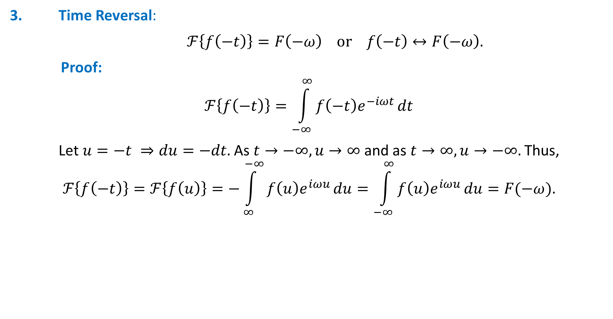
Properties of Fourier transform
3. Time Reversal:
$ℱ\left\{f\left(−t\right)\right\}=F\left(−ω\right) or f\left(−t\right)↔F\left(−ω\right).$
Proof:
$$ℱ\left\{f\left(−t\right)\right\}=\int_{−∞}^{∞}{f\left(−t\right)e^{−iωt}}dt$$
Let $u=−t ⇒du=−dt.$ As $t→−∞,u→∞$ and as $t→∞,u→−∞.$ Thus,
$$ℱ\left\{f\left(−t\right)\right\}=ℱ\left\{f\left(u\right)\right\}=−\int_{∞}^{−∞}{f\left(u\right)e^{iωu}}du=\int_{−∞}^{∞}{f\left(u\right)e^{iωu}}du=F(−ω).$$
Notes:
Outline:
Central Scientific Problem – Artificial Intelligence
Machine Learning:
Definition
Specifics
Requirements
Existing Solutions and their limitations
Multiresolution Approximation: Limitation
Our Approach. Results. Binarization. Plans.

Slide 10
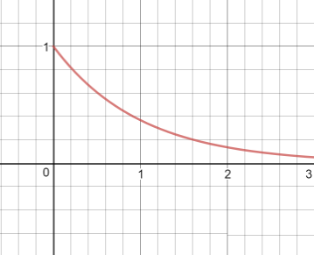
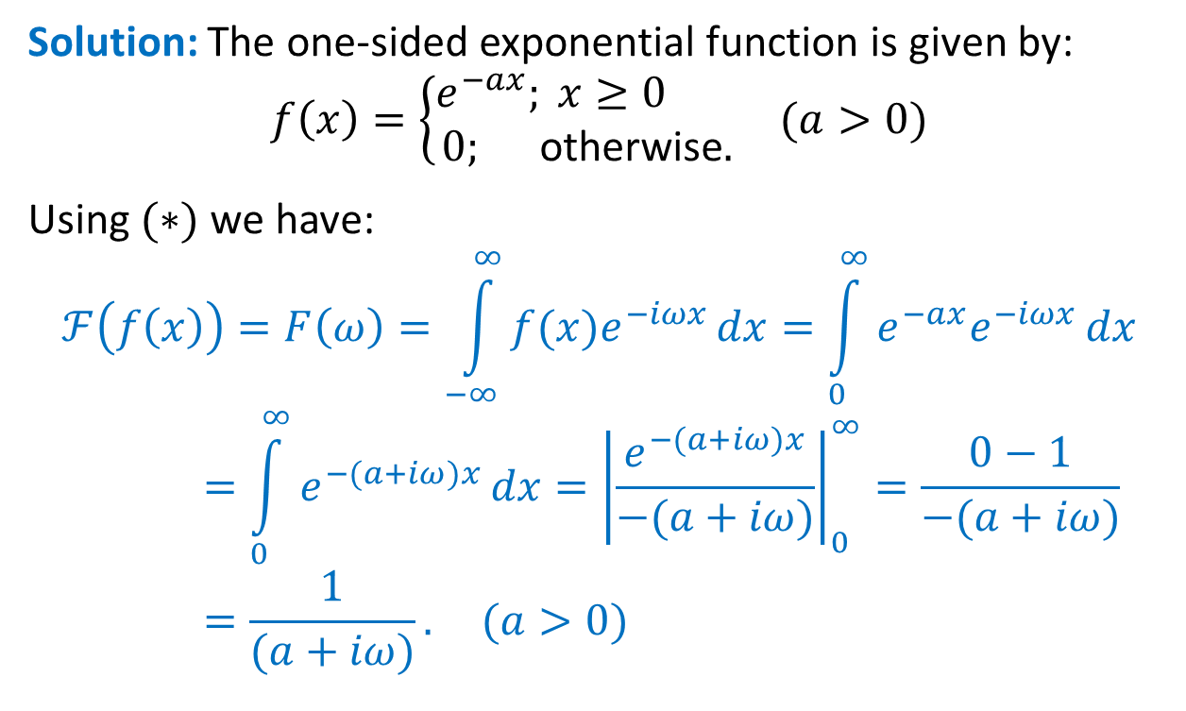
Example:
Find the Fourier transform of the one-sided exponential function $f\left(x\right)=H\left(x\right)e^{−ax} (a>0)$
where $H(x)$ is the Heaviside unit step function.
Solution: The one-sided exponential function is given by:
$f\left(x\right)=\left\{\begin{aligned}e^{−ax}; x≥0 \\ \text{0}\text{; }\text{otherwise}.\end{aligned}\right.$ $(a>0)$
Using $(∗)$ we have:
$$ℱ\left(f\left(x\right)\right)=F\left(ω\right)=\int_{−∞}^{∞}{f(x)e^{−iωx}}dx=\int_{0}^{∞}{e^{−ax}e^{−iωx}}dx=\int_{0}^{∞}{e^{−(a+iω)x}}dx={\left|\frac{e^{−(a+iω)x}}{−(a+iω)}\right|}_{0}^{∞}=\frac{0−1}{−(a+iω)}=\frac{1}{(a+iω)}. (a>0)$$
one-sided decaying exponential function

Slide 11
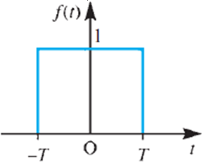
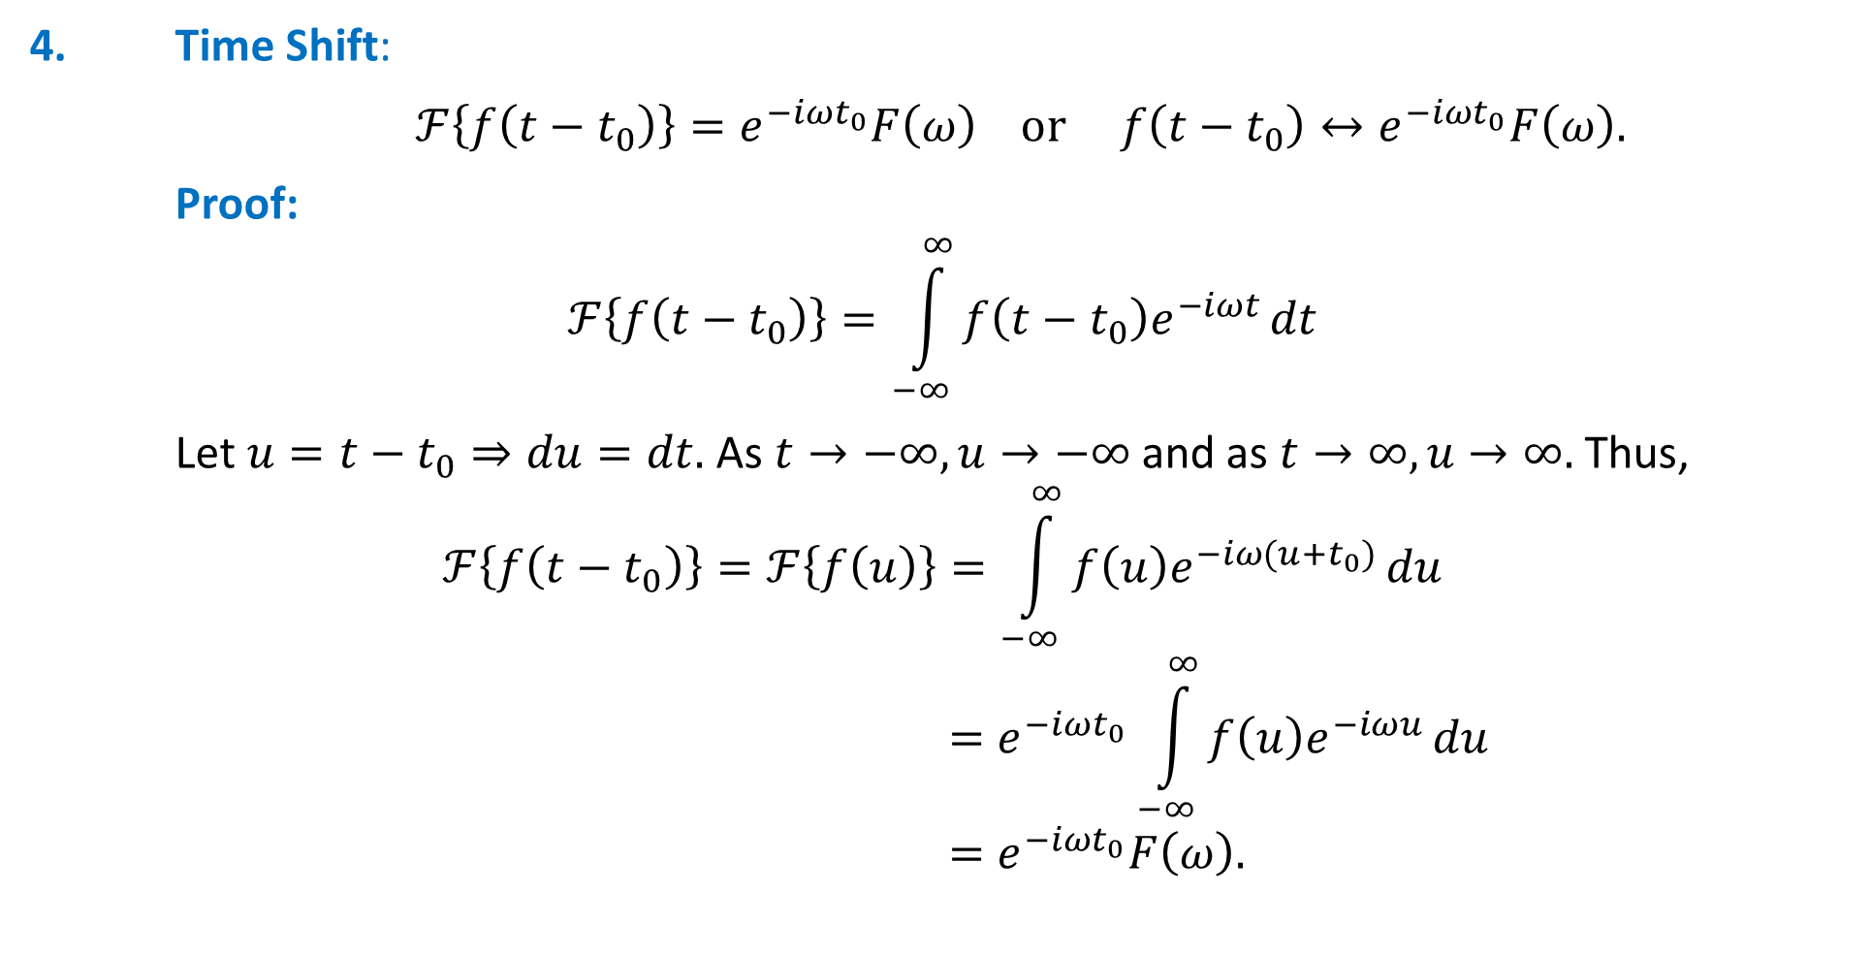
Example-1:
Find the Fourier transform of rectangular pulse signal: $f\left(t\right)=\left\{\begin{aligned}1; \left|t\right|<T \\ \text{0; }\left|t\right|>T.\end{aligned}\right.$
Solution:
Using $(∗)$ we have:
$$ℱ\left(f\left(t\right)\right)=F\left(ω\right)=\int_{−∞}^{∞}{f(t)e^{−iωt}}dt=\int_{−T}^{T}{e^{−iωt}}dt$$
$$={\left|\frac{e^{−iωx}}{−iω}\right|}_{−T}^{T}=\frac{2}{ω}\left(\frac{e^{iωT}−e^{−iωT}}{2i}\right)=2\frac{\sin{ωT}}{ω}=2T\operatorname{sinc}{ωT},$$
where $sinc ω$ is defined, as:
$$\operatorname{sinc}{ωT}=\left\{\begin{aligned}\frac{\sin{ωT}}{ωT}; (ω≠0) \\ 1; \left(ω=0\right) \end{aligned}\right.$$
The rectangular pulse

Slide 16
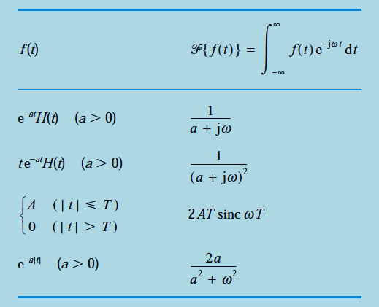
Table: A brief table of Fourier transforms.

Slide 17
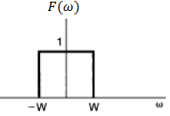
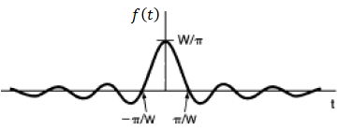
Example-2:
Consider the signal whose Fourier transform is: $ℱ\left(f\left(t\right)\right)=F\left(ω\right)=\left\{\begin{aligned}1; \left|ω\right|<W \\ \text{0; }\left|ω\right|>W\end{aligned}\right.$
Determine the original signal in time-domain.
Solution:
Using $(∗∗)$ we have:
$$ℱ^{−1}\left(F\left(ω\right)\right)=f\left(t\right)=\frac{1}{2π}\int_{−∞}^{∞}{F(ω)e^{iωt}}dω=\frac{1}{2π}\int_{−W}^{W}{e^{iωt}}dt$$
$$={\frac{1}{2π}\left|\frac{e^{iωt}}{it}\right|}_{−W}^{W}=\frac{1}{πt}\left(\frac{e^{iWt}−e^{−iWt}}{2i}\right)=\frac{\sin{Wt}}{πt}=\frac{W}{π}\left(\frac{\sin{Wt}}{Wt}\right)=\frac{W}{π}\operatorname{sinc}{Wt},$$
where $sinc Wt$ is defined, as:
$$\operatorname{sinc}{Wt}=\left\{\begin{aligned}\frac{\sin{Wt}}{Wt}; (ω≠0) \\ 1; \left(ω=0\right) \end{aligned}\right.$$

Slide 18
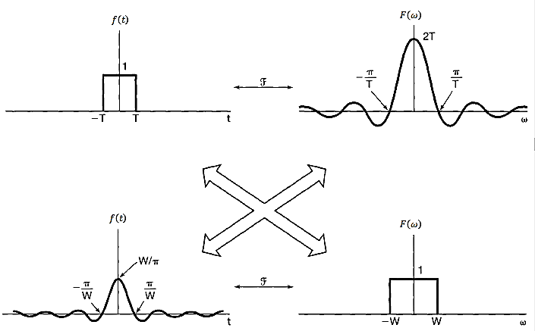
Relationship between the Fourier transform pairs of examples (1) and (2)

Slide 19
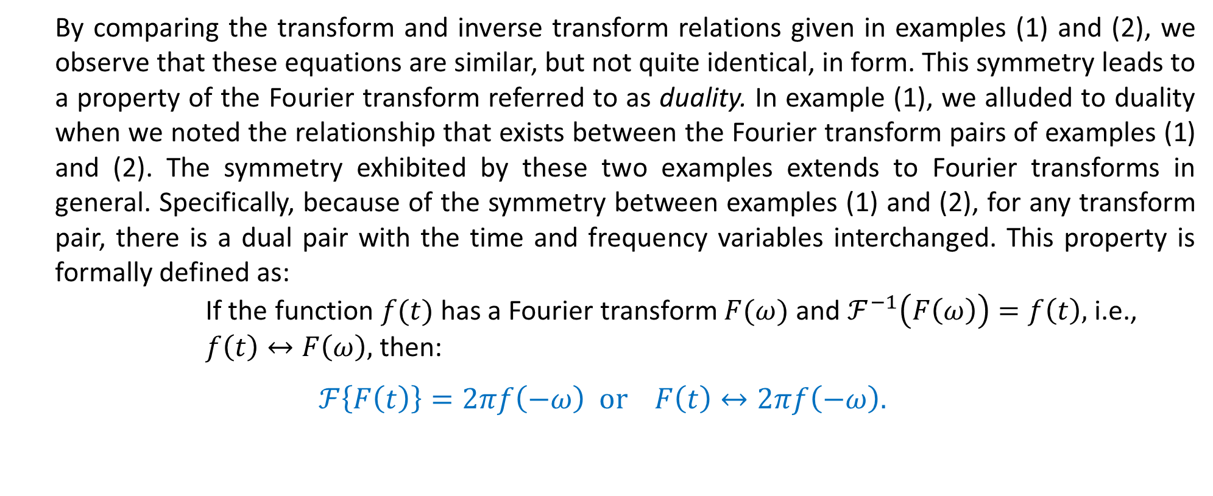
Properties of the Fourier Transform
9. Duality (Symmetry Property)
By comparing the transform and inverse transform relations given in examples (1) and (2), we observe that these equations are similar, but not quite identical, in form. This symmetry leads to a property of the Fourier transform referred to as duality. In example (1), we alluded to duality when we noted the relationship that exists between the Fourier transform pairs of examples (1) and (2). The symmetry exhibited by these two examples extends to Fourier transforms in general. Specifically, because of the symmetry between examples (1) and (2), for any transform pair, there is a dual pair with the time and frequency variables interchanged. This property is formally defined as:
If the function $f(t)$ has a Fourier transform $F(ω)$ and $ℱ^{−1}\left(F\left(ω\right)\right)=f\left(t\right),$ i.e., $f\left(t\right)↔F\left(ω\right),$then:
$$ℱ\left\{F\left(t\right)\right\}=2πf\left(−ω\right) or F\left(t\right)↔2πf\left(−ω\right).$$

Slide 28
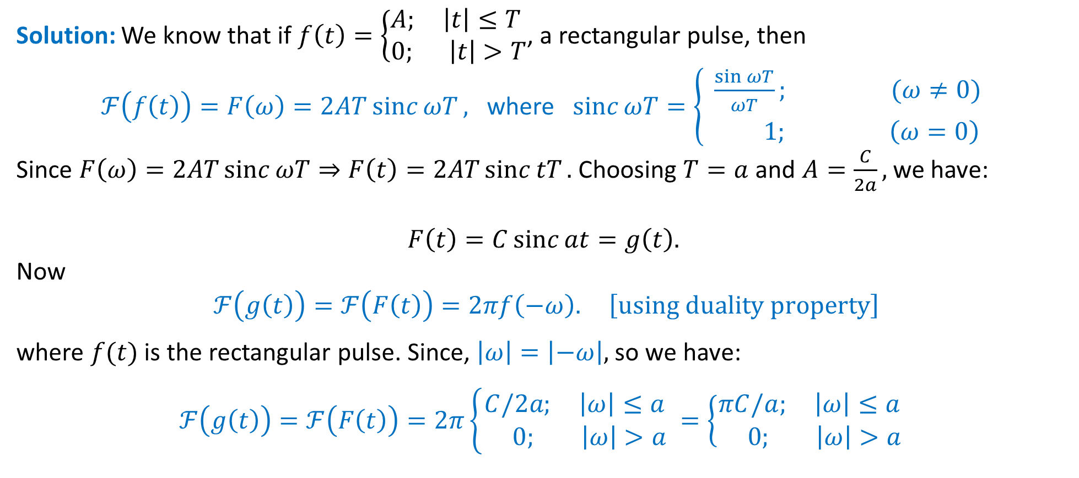
Example-3:
Determine the Fourier transform of the signal: $g\left(t\right)=C\operatorname{sinc}{at}=\left\{\begin{aligned}\frac{C\sin{at}}{at}; (t≠0) \\ C; \left(t=0\right) \end{aligned}\right.$
Solution: We know that if $f\left(t\right)=\left\{\begin{aligned}A; \left|t\right|≤T \\ \text{0; }\left|t\right|>T\end{aligned}\right.$, a rectangular pulse, then
$ℱ\left(f\left(t\right)\right)=F\left(ω\right)=2AT\operatorname{sinc}{ωT},$ where $\operatorname{sinc}{ωT}=\left\{\begin{aligned}\frac{\sin{ωT}}{ωT}; (ω≠0) \\ 1; \left(ω=0\right) \end{aligned}\right.$
Since $F\left(ω\right)=2AT\operatorname{sinc}{ωT}⇒F\left(t\right)=2AT\operatorname{sinc}{tT}.$ Choosing $T=a$ and $A=\frac{C}{2a},$ we have:
$$F\left(t\right)=C\operatorname{sinc}{at}=g\left(t\right).$$
Now
$$ℱ\left(g\left(t\right)\right)=ℱ\left(F\left(t\right)\right)=2πf\left(−ω\right). \left[using duality property\right]$$
where $f(t)$ is the rectangular pulse. Since, $\left|ω\right|=\left|−ω\right|,$ so we have:
$$ℱ\left(g\left(t\right)\right)=ℱ\left(F\left(t\right)\right)=2π\left\{\begin{aligned}C/2a; \left|ω\right|≤a \\ \text{0; } \left|ω\right|>a \end{aligned}=\left\{\begin{aligned}πC/a; \left|ω\right|≤a \\ \text{0; }\left|ω\right|>a \end{aligned}\right.\right.$$

Slide 29
The continuous Fourier spectra
From the brief table of Fourier transforms, it is clear that Fourier transforms are generally complex-valued functions of the real frequency variable $w$. If $ℱ\{f(t)\}=F(ω)$ is the Fourier transform of the signal $f(t)$ then $F(ω)$ is also known as the (complex) frequency spectrum of $f(t)$. Writing $F(ω)$ in the exponential form:
$$F\left(ω\right)=\left|F\left(ω\right)\right|e^{i\arg{F\left(ω\right)}},$$
plots of $|F(ω)|$ and $arg⁡F(ω)$, which are both real-valued functions of $ω$, are called the amplitude and phase spectra respectively of the signal $f(t)$. These two spectra represent the frequency-domain portrait of the signal $f(t)$. In contrast to the situation when $f(t)$ was periodic, where the amplitude and phase spectra were defined only at discrete values of $ω,$ we now see that both spectra are defined for all values of the continuous variable $ω$.

Slide 30
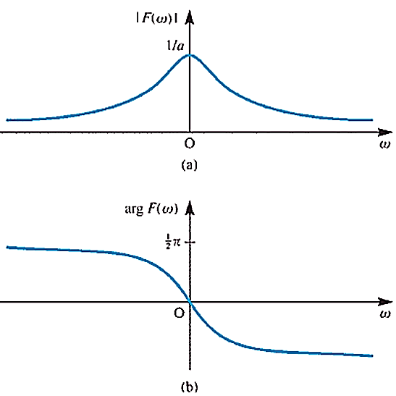
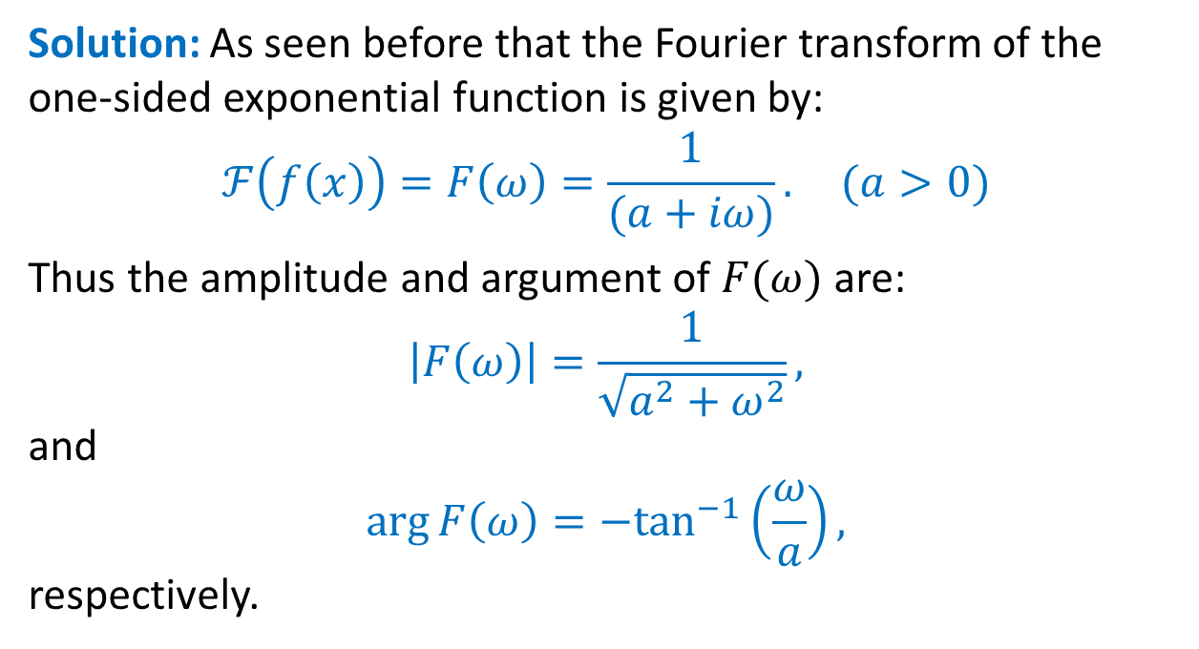
Example:
Determine the amplitude and phase spectra of the signal $f\left(x\right)=H\left(x\right)e^{−ax} \left(a>0\right),$ and plot their graphs.
Solution: As seen before that the Fourier transform of the one-sided exponential function is given by:
$$ℱ\left(f\left(x\right)\right)=F\left(ω\right)=\frac{1}{(a+iω)}. (a>0)$$
Thus the amplitude and argument of $F(ω)$ are:
$$\left|F\left(ω\right)\right|=\frac{1}{\sqrt{a^{2}+ω^{2}}},$$
and
$$\arg{F\left(ω\right)}=−\tan^{−1}\left(\frac{ω}{a}\right),$$
respectively.
(a) Amplitude and (b) phase spectra of the one-sided exponential function

Slide 31
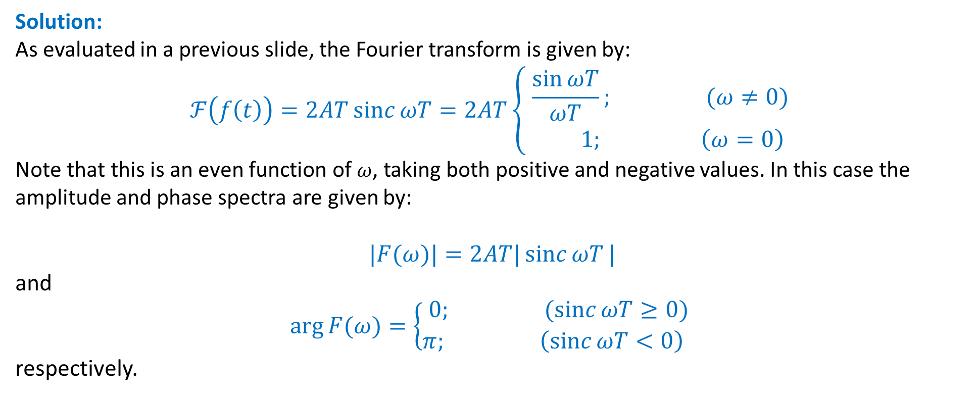
Example:
Determine amplitude and phase spectra of the signal $f\left(t\right)=\left\{\begin{aligned}A; \left|t\right|<T \\ \text{0; }\left|t\right|>T\end{aligned}\right.$ and plot their graphs.
Solution:
As evaluated in a previous slide, the Fourier transform is given by:
$$ℱ\left(f\left(t\right)\right)=2AT\operatorname{sinc}{ωT}=2AT\left\{\begin{aligned}\frac{\sin{ωT}}{ωT}; (ω≠0) \\ 1; \left(ω=0\right) \end{aligned}\right.$$
Note that this is an even function of $ω$, taking both positive and negative values. In this case the amplitude and phase spectra are given by:
$$|F(ω)|=2AT|\operatorname{sinc}{ωT}|$$
and
$$arg⁡F(ω)=\left\{\begin{aligned}0; (\operatorname{sinc}{ωT}≥0) \\ π; \left(\operatorname{sinc}{ωT}<0\right) \end{aligned}\right.$$
respectively.

Slide 32
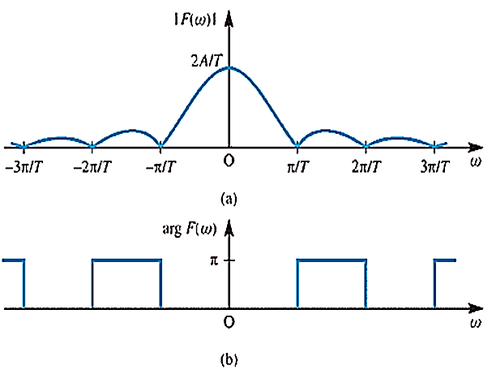
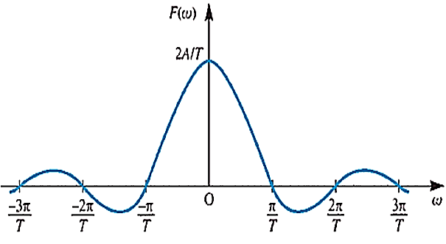
Amplitude and
spectra of the pulse
Frequency spectrum (real-valued) of the pulse

Slide 33
Properties of Fourier transform
4. Time Shift:
$ℱ\left\{f\left(t−t_{0}\right)\right\}=e^{−iωt_{0}}F\left(ω\right) or f\left(t−t_{0}\right)↔e^{−iωt_{0}}F\left(ω\right).$
Proof:
$$ℱ\left\{f\left(t−t_{0}\right)\right\}=\int_{−∞}^{∞}{f\left(t−t_{0}\right)e^{−iωt}}dt$$
Let $u=t−t_{0}⇒du=dt.$ As $t→−∞,u→−∞$ and as $t→∞,u→∞.$ Thus,
$$ℱ\left\{f\left(t−t_{0}\right)\right\}=ℱ\left\{f\left(u\right)\right\}=\int_{−∞}^{∞}{f\left(u\right)e^{−iω(u+t_{0})}}du$$
$$=e^{−iωt_{0}}\int_{−∞}^{∞}{f\left(u\right)e^{−iωu}}du$$
$$=e^{−iωt_{0}}F\left(ω\right).$$
Notes:
Outline:
Central Scientific Problem – Artificial Intelligence
Machine Learning:
Definition
Specifics
Requirements
Existing Solutions and their limitations
Multiresolution Approximation: Limitation
Our Approach. Results. Binarization. Plans.

Slide 38
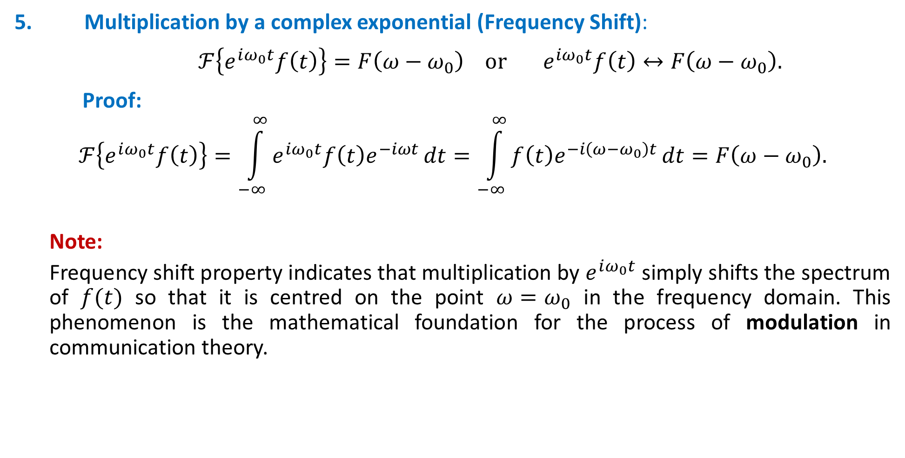
Properties of Fourier transform
5. Multiplication by a complex exponential (Frequency Shift):
$ℱ\left\{e^{iω_{0}t}f\left(t\right)\right\}=F\left(ω−ω_{0}\right) or e^{iω_{0}t}f\left(t\right)↔F\left(ω−ω_{0}\right).$
Proof:
$$ℱ\left\{e^{iω_{0}t}f\left(t\right)\right\}=\int_{−∞}^{∞}{e^{iω_{0}t}f\left(t\right)e^{−iωt}}dt=\int_{−∞}^{∞}{f\left(t\right)e^{−i\left(ω−ω_{0}\right)t}}dt=F\left(ω−ω_{0}\right).$$
Note:
Frequency shift property indicates that multiplication by $e^{iω_{0}t}$ simply shifts the spectrum of $f(t)$ so that it is centred on the point $ω=ω_{0}$ in the frequency domain. This phenomenon is the mathematical foundation for the process of modulation in communication theory.
Notes:
Outline:
Central Scientific Problem – Artificial Intelligence
Machine Learning:
Definition
Specifics
Requirements
Existing Solutions and their limitations
Multiresolution Approximation: Limitation
Our Approach. Results. Binarization. Plans.

Slide 39
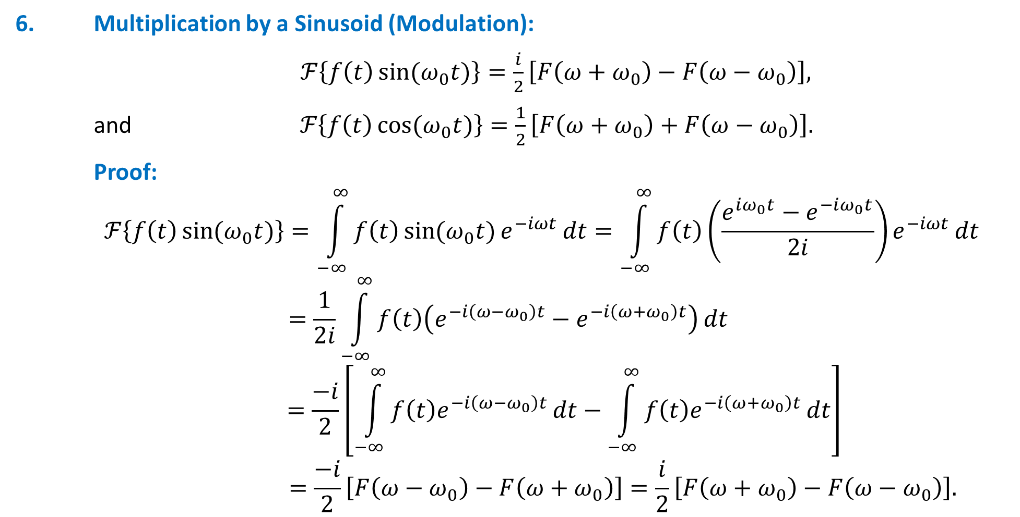
Properties of Fourier transform
6. Multiplication by a Sinusoid (Modulation):
$ℱ\left\{f\left(t\right)\sin{(ω_{0}t)}\right\}=\frac{i}{2}\left[F\left(ω+ω_{0}\right)−F\left(ω−ω_{0}\right)\right],$
and$ℱ\left\{f\left(t\right)\cos{(ω_{0}t)}\right\}=\frac{1}{2}\left[F\left(ω+ω_{0}\right)+F\left(ω−ω_{0}\right)\right].$
Proof:
$$ℱ\left\{f\left(t\right)\sin{(ω_{0}t)}\right\}=\int_{−∞}^{∞}{f\left(t\right)\sin{(ω_{0}t)}e^{−iωt}}dt=\int_{−∞}^{∞}{f\left(t\right)\left(\frac{e^{iω_{0}t}−e^{−iω_{0}t}}{2i}\right)e^{−iωt}}dt$$
$$=\frac{1}{2i}\int_{−∞}^{∞}{f\left(t\right)\left(e^{−i\left(ω−ω_{0}\right)t}−e^{−i\left(ω+ω_{0}\right)t}\right)}dt$$
$$=\frac{−i}{2}\left[\int_{−∞}^{∞}{f\left(t\right)e^{−i\left(ω−ω_{0}\right)t}}dt−\int_{−∞}^{∞}{f\left(t\right)e^{−i\left(ω+ω_{0}\right)t}}dt\right]$$
$$=\frac{−i}{2}\left[F\left(ω−ω_{0}\right)−F\left(ω+ω_{0}\right)\right]=\frac{i}{2}\left[F\left(ω+ω_{0}\right)−F\left(ω−ω_{0}\right)\right].$$
Notes:
Outline:
Central Scientific Problem – Artificial Intelligence
Machine Learning:
Definition
Specifics
Requirements
Existing Solutions and their limitations
Multiresolution Approximation: Limitation
Our Approach. Results. Binarization. Plans.

Slide 40
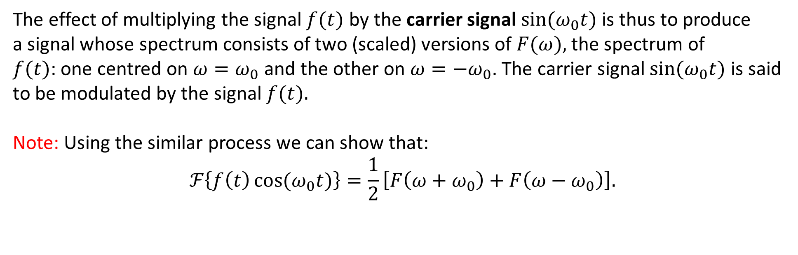
Properties of Fourier transform
The effect of multiplying the signal $f(t)$ by the carrier signal $\sin{(ω_{0}t)}$is thus to produce
a signal whose spectrum consists of two (scaled) versions of $F(ω),$ the spectrum of
$f(t)$: one centred on $ω=ω_{0}$ and the other on $ω=−ω_{0}$. The carrier signal $\sin{(ω_{0}t)}$ is said
to be modulated by the signal $f(t).$
Note: Using the similar process we can show that:
$$ℱ\left\{f\left(t\right)\cos{(ω_{0}t)}\right\}=\frac{1}{2}\left[F\left(ω+ω_{0}\right)+F\left(ω−ω_{0}\right)\right].$$

Slide 43
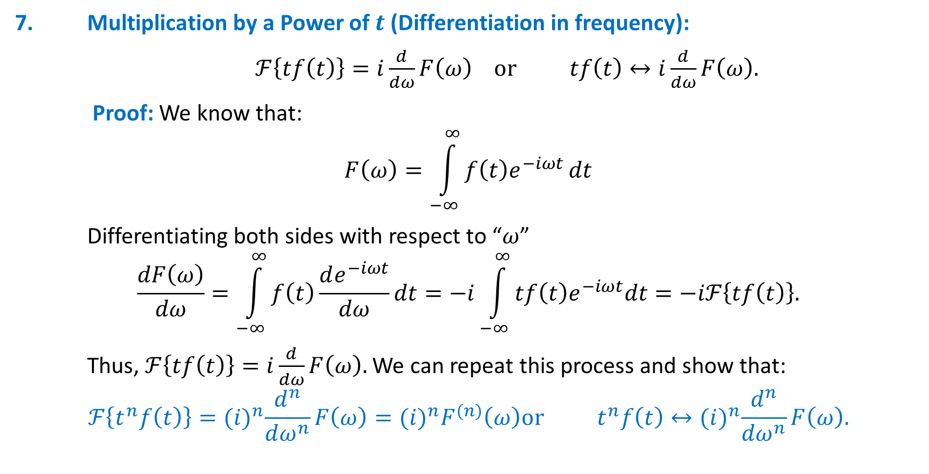
Properties of Fourier transform
7. Multiplication by a Power of $t$ (Differentiation in frequency):
$ℱ\left\{tf\left(t\right)\right\}=i\frac{d}{dω}F\left(ω\right) or tf\left(t\right)↔i\frac{d}{dω}F\left(ω\right).$
Proof: We know that:
$$F\left(ω\right)=\int_{−∞}^{∞}{f\left(t\right)e^{−iωt}}dt$$
Differentiating both sides with respect to “$ω$”
$$\frac{dF\left(ω\right)}{dω}=\int_{−∞}^{∞}{f\left(t\right)\frac{de^{−iωt}}{dω}dt}=−i\int_{−∞}^{∞}{tf\left(t\right)e^{−iωt}dt}=−iℱ\left\{tf\left(t\right)\right\}.$$
Thus, $ℱ\left\{tf\left(t\right)\right\}=i\frac{d}{dω}F\left(ω\right).$ We can repeat this process and show that:
$$ℱ\left\{t^{n}f\left(t\right)\right\}={(i)}^{n}\frac{d^{n}}{dω^{n}}F\left(ω\right)={(i)}^{n}F^{(n)}\left(ω\right)or t^{n}f\left(t\right)↔{(i)}^{n}\frac{d^{n}}{dω^{n}}F\left(ω\right).$$
Notes:
Outline:
Central Scientific Problem – Artificial Intelligence
Machine Learning:
Definition
Specifics
Requirements
Existing Solutions and their limitations
Multiresolution Approximation: Limitation
Our Approach. Results. Binarization. Plans.

Slide 44
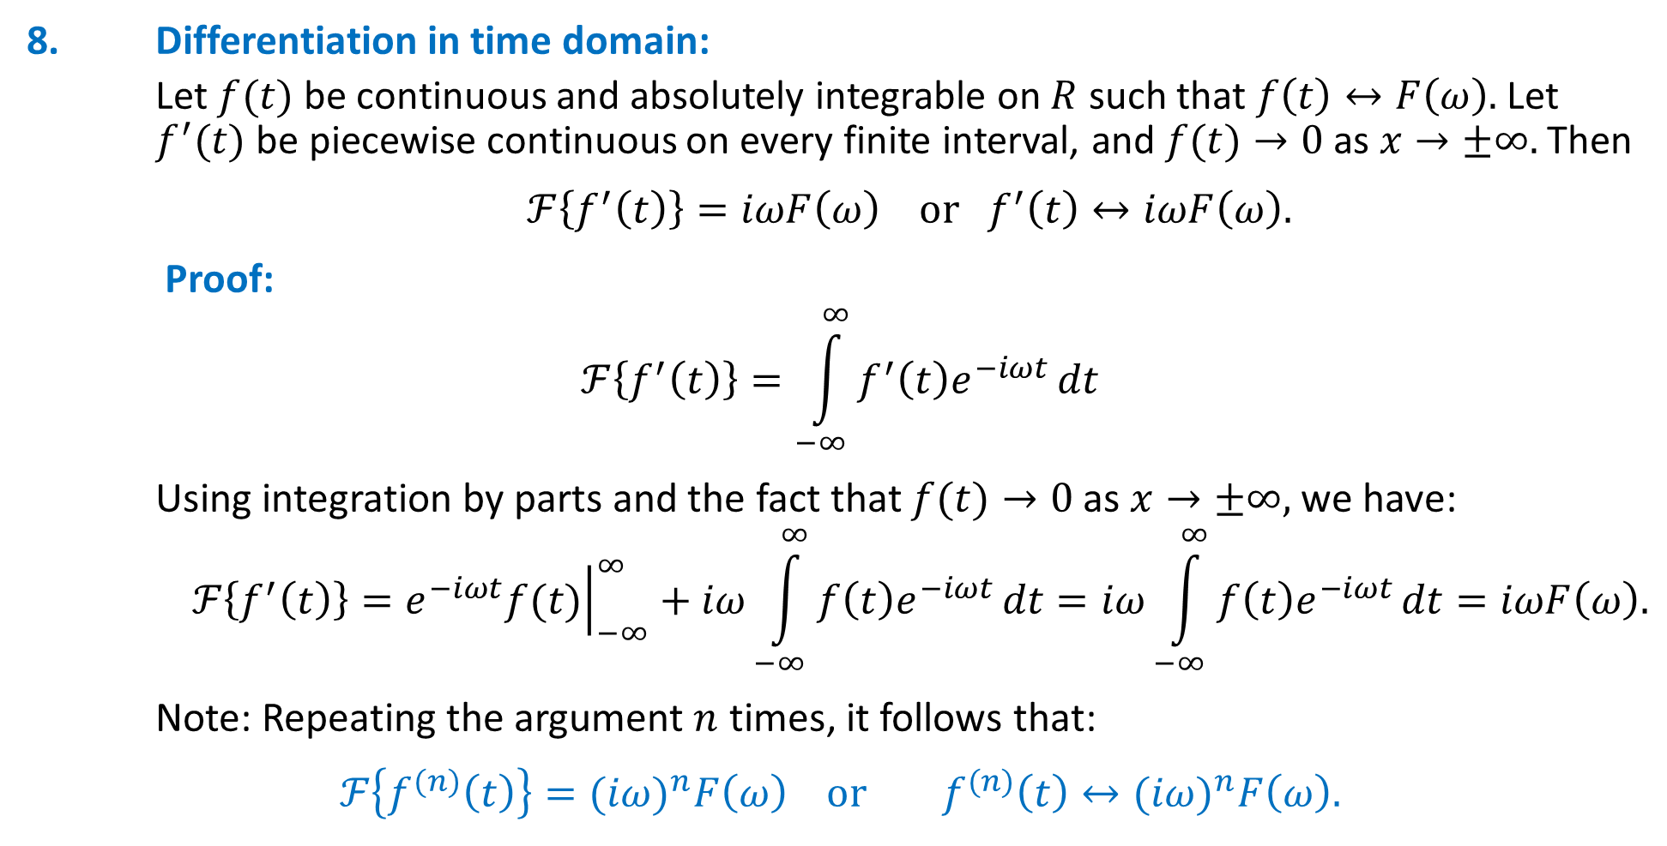
Properties of Fourier transform
8. Differentiation in time domain:
Let $f(t)$ be continuous and absolutely integrable on $R$ such that $f\left(t\right)↔F\left(ω\right).$ Let $f^{′}(t)$ be piecewise continuous on every finite interval, and $f(t)→0$ as $x→±∞.$ Then
$ℱ\left\{f^{′}\left(t\right)\right\}=iωF\left(ω\right) or f^{′}\left(t\right)↔iωF\left(ω\right).$
Proof:
$$ℱ\left\{f^{′}\left(t\right)\right\}=\int_{−∞}^{∞}{f^{′}\left(t\right)e^{−iωt}}dt$$
Using integration by parts and the fact that $f(t)→0$ as $x→±∞,$ we have:
$$ℱ\left\{f^{′}\left(t\right)\right\}={\left.e^{−iωt}f(t)\right|}_{−∞}^{∞}+iω\int_{−∞}^{∞}{f\left(t\right)e^{−iωt}}dt=iω\int_{−∞}^{∞}{f\left(t\right)e^{−iωt}}dt=iωF\left(ω\right).$$
Note: Repeating the argument $n$ times, it follows that:
$$ℱ\left\{f^{(n)}\left(t\right)\right\}={(iω)}^{n}F\left(ω\right) or f^{(n)}\left(t\right)↔{(iω)}^{n}F\left(ω\right).$$
Notes:
Outline:
Central Scientific Problem – Artificial Intelligence
Machine Learning:
Definition
Specifics
Requirements
Existing Solutions and their limitations
Multiresolution Approximation: Limitation
Our Approach. Results. Binarization. Plans.

Slide 45
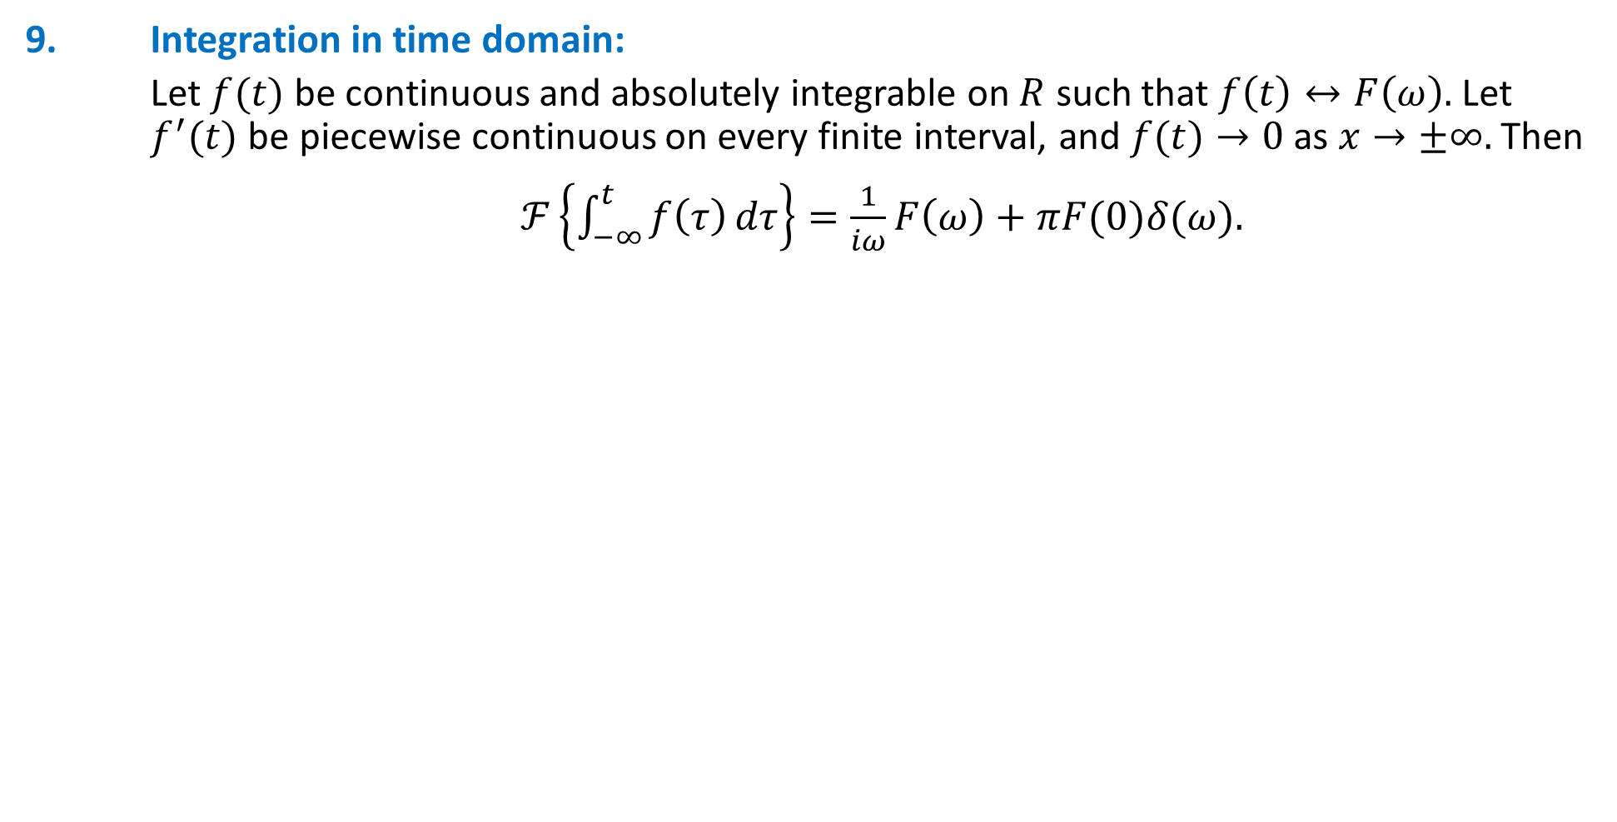
Properties of Fourier transform
9. Integration in time domain:
Let $f(t)$ be continuous and absolutely integrable on $R$ such that $f\left(t\right)↔F\left(ω\right).$ Let $f^{′}(t)$ be piecewise continuous on every finite interval, and $f(t)→0$ as $x→±∞.$ Then
$ℱ\left\{\int_{−∞}^{t}{f\left(τ\right)}dτ\right\}=\frac{1}{iω}F\left(ω\right)+πF(0)δ(ω).$
Notes:
Outline:
Central Scientific Problem – Artificial Intelligence
Machine Learning:
Definition
Specifics
Requirements
Existing Solutions and their limitations
Multiresolution Approximation: Limitation
Our Approach. Results. Binarization. Plans.

Slide 46
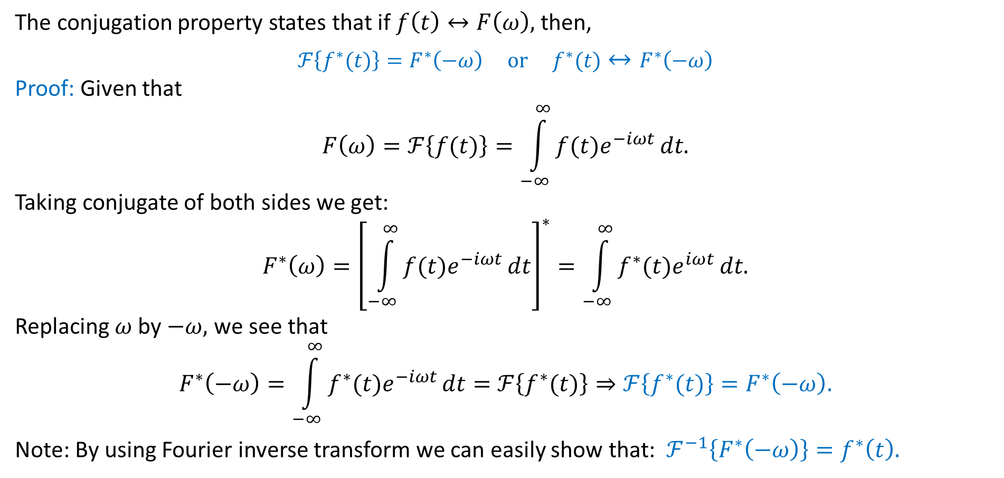
Properties of the Fourier Transform
10. Conjugation and Conjugate Symmetry
The conjugation property states that if $f\left(t\right)↔F\left(ω\right),$ then,
$$ℱ\left\{f^{∗}(t)\right\}=F^{∗}\left(−ω\right) or f^{∗}(t)↔F^{∗}\left(−ω\right)$$
Proof: Given that
$$F\left(ω\right)=ℱ\left\{f(t)\right\}=\int_{−∞}^{∞}{f(t)e^{−iωt}}dt.$$
Taking conjugate of both sides we get:
$$F^{∗}\left(ω\right)={\left[\int_{−∞}^{∞}{f(t)e^{−iωt}}dt\right]}^{∗}=\int_{−∞}^{∞}{f^{∗}(t)e^{iωt}}dt.$$
Replacing $ω$ by $−ω,$ we see that
$$F^{∗}\left(−ω\right)=\int_{−∞}^{∞}{f^{∗}(t)e^{−iωt}}dt=ℱ\left\{f^{∗}(t)\right\}⇒ℱ\left\{f^{∗}(t)\right\}=F^{∗}\left(−ω\right).$$
Note: By using Fourier inverse transform we can easily show that: $ℱ^{−1}\left\{F^{∗}\left(−ω\right)\right\}=f^{∗}\left(t\right).$

Slide 47
Fourier Transform of some important functions
Dirac delta function
Signum function
Unit step function (also known as Heaviside unit step function)
Sinusoidal Signals

Slide 48
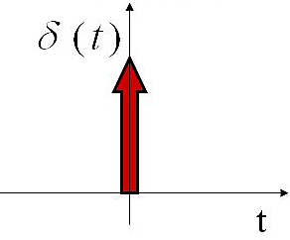
Dirac delta function (unit impulse)
Dirac’s delta function is defined by the following property
$$δ\left(t\right)=\left\{\begin{aligned}∞; t=0 \\ 0; t≠0\end{aligned}\right. \left(1\right)$$
with
$$\int_{−∞}^{∞}{δ\left(t\right)dt}=1. (2)$$
It is “infinitely peaked” at $t=0$ with the total area of unity. Mathematically, the delta function is not a function, because it is too singular. Instead, it is said to be a “distribution.” In fact, $\int{δ\left(t\right)dt}$ can be regarded as an “operator” which pulls the value of a function at zero. This means that we never talk about value of $δ(t)$ instead we talk about the value of integrals involving $δ\left(t\right).$ An important property of the delta function is the following relation:
$$\int{f\left(t\right)δ\left(t\right)dt=f(0)}$$
for any function $f(t)$. This equation can easily be generalized to:
$$\int{f\left(t\right)δ\left(t−t_{0}\right)dt=f\left(t_{0}\right).}$$

Slide 49
Fourier Transform of Dirac delta function (unit impulse)
Fourier transform of the unit impulse is:
$$\int_{−∞}^{∞}{δ(t)e^{−iωt}dt}=1⇒δ(t)↔1$$
That is, the unit impulse has a Fourier transform consisting of equal contributions at frequencies.
Applying the duality property we have:
$$f\left(t\right)=1,t∈ℝ↔2πδ(ω)$$
generalized Fourier transform of the constant signal $f\left(t\right)=1,t∈ℝ$

Slide 52
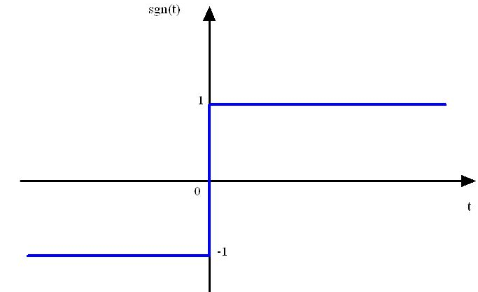
Fourier Transform of a Signum function
Signum function is defined as:
$$\operatorname{sgn}{(t)}=\left\{\begin{aligned}−1; t<0 \\ 0; t=0 \\ 1; t>0\end{aligned}\right.$$
The signum function does not satisfy the Dirichlet conditions, and therefore, strictly speaking, it does not have a Fourier transform. Consider the following exponential pulse :
$$g{(t)}=e^{−at}u\left(t\right)−e^{at}u\left(−t\right)=\left\{\begin{aligned}−e^{at}; t<0 \\ 0; t=0 \\ e^{−at}; t>0\end{aligned}\right. \left(a>0\right).$$
Note that
$$\lim_{a→0}{g\left(t\right)=\operatorname{sgn}{(t)}}$$

Slide 53
Fourier Transform of a Signum function
Thus,
$$ℱ\{\operatorname{sgn}{(t)\}}=\lim_{a→0}{ℱ\left\{g\left(t\right)\right\}}$$
Now
$$\lim_{a→0}{ℱ\left\{g\left(t\right)\right\}}=\lim_{a→0}ℱ\left\{e^{−at}u\left(t\right)−e^{at}u\left(−t\right)\right\}$$
$=\lim_{a→0}\left[ℱ\{e^{−at}u\left(t\right)\}−ℱ\{e^{at}u\left(−t\right)\}\right]$
$=\lim_{a→0}\left[ℱ\{e^{−at}u\left(t\right)\}−ℱ\{e^{at}u\left(−t\right)\}\right]$
$=\lim_{a→0}\left[\frac{1}{a+iw}−\frac{1}{a−iw}\right]=\lim_{a→0}\left[\frac{−2iw}{a^{2}+w^{2}}\right]=\frac{2}{iw} \left(a>0\right).$
Hence,
$$\operatorname{sgn}{(t)}{↔}\frac{2}{iw}.$$

Slide 54
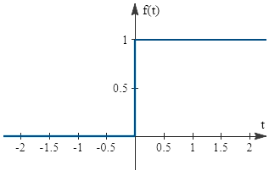
Fourier Transform of Heaviside unit step function
Heaviside unit step function is defined as:
$$u{(t)}=\left\{\begin{aligned}1; t≥0 \\ 0; t<0\end{aligned}\right.$$
The unit step function does not satisfy the Dirichlet conditions, and therefore, strictly speaking, it does not have a Fourier transform. Heaviside unit step function can be defined in terms of unit impulse as:
$$u\left(t\right)=\int_{−∞}^{t}{δ(τ) dτ}$$
Using the integration property:
$$\int_{−∞}^{t}{f(τ) dτ}↔\frac{F(ω)}{iω}+πF\left(0\right)δ\left(ω\right),$$
Fourier transform of the Heaviside unit step function is given by:
$$u\left(t\right)↔\frac{1}{iw}+πδ\left(ω\right),$$
where $f\left(t\right)=δ\left(t\right),$ $F\left(ω\right)=ℱ\left\{δ\left(t\right)\right\}=1 and F(0) =1.$

Slide 55
Fourier Transform of Heaviside unit step function
Alternative Method:
Heaviside unit step function can be defined in terms of signum function as:
$$u\left(t\right)=\frac{sgn\left(t\right)+1}{2}$$
By using above definition, Fourier transform of the Heaviside unit step function is given by:
$$ℱ\left\{u\left(t\right)\right\}=ℱ\left\{\frac{sgn\left(t\right)+1}{2} \right\}=\frac{1}{2}\left[ℱ\left\{sgn\left(t\right)\right\}+ℱ\{1\}\right]=\frac{1}{2}\left[\frac{2}{iw}+2πδ(ω)\right]=\frac{1}{iw}+πδ(ω)$$
Hence,
$$u\left(t\right)↔\frac{1}{iw}+πδ(ω)$$

Slide 56
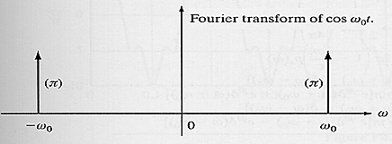
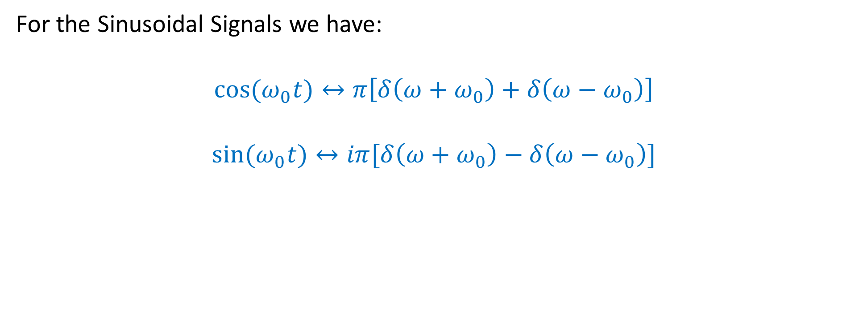
Fourier Transform of Sinusoidal Signals
For the Sinusoidal Signals we have:
$$\cos{(ω_{0}t)}↔π\left[δ\left(ω+ω_{0}\right)+δ\left(ω−ω_{0}\right)\right]$$
$$\sin{(ω_{0}t)}↔iπ[δ\left(ω+ω_{0}\right)−δ\left(ω−ω_{0}\right)]$$

Slide 57
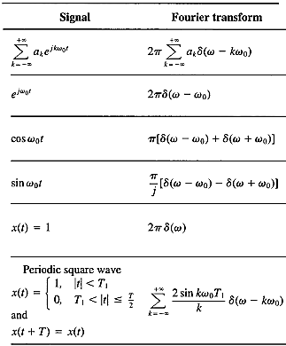
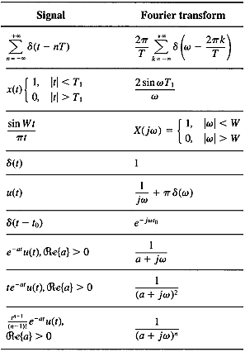
Common Fourier Transform Pairs

Slide 58
Convolution:
Let $f(t)$ and $g(t)$ be piecewise continuous functions on $R$. The convolution of $f$ and $g,$ denoted by $f∗g,$ is defined by:
$$f\left(t\right)∗g\left(t\right)=\left(f∗g\right)(t)=\int_{−∞}^{∞}{f\left(u\right)g\left(t−u\right)du.}$$
It can be easily verified that
$f∗g=g∗f$
$f∗\left(g+h\right)=f∗g+f∗h$
$f∗0=0$

Slide 59
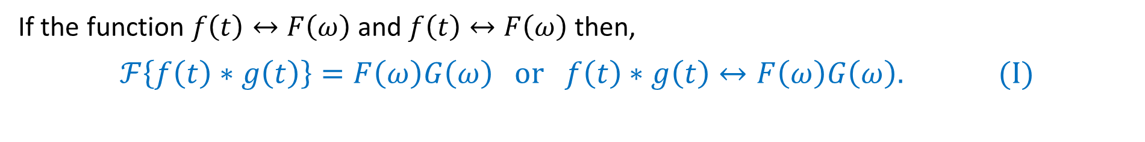
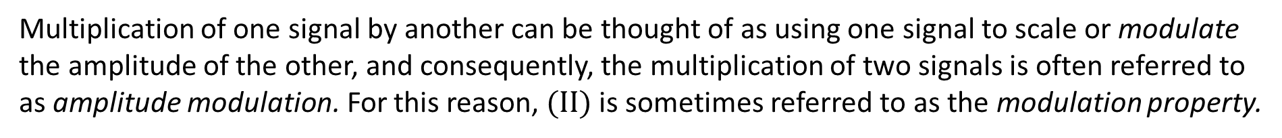
Properties of the Fourier Transform
11. Convolution in the Time Domain (Multiplication in the Frequency):
If the function $f\left(t\right)↔F\left(ω\right)$ and $f\left(t\right)↔F\left(ω\right)$then,
$$ℱ\left\{f\left(t\right)∗g\left(t\right)\right\}=F\left(ω\right)G\left(ω\right) or f\left(t\right)∗g\left(t\right)↔F\left(ω\right)G\left(ω\right). (I)$$
Equation $(I)$ is of major importance in signal and system analysis. As expressed in this equation, the Fourier transform maps the convolution of two signals into the product of their Fourier transforms.
12. Convolution in the Frequency (Multiplication in the Time Domain):
If the function $f\left(t\right)↔F\left(ω\right)$ and $f\left(t\right)↔F\left(ω\right)$then,
$$ℱ\left\{f\left(t\right)g\left(t\right)\right\}=\frac{1}{2π}F\left(ω\right)∗G\left(ω\right) or f\left(t\right)g\left(t\right)↔\frac{1}{2π}F\left(ω\right)∗G\left(ω\right). (II)$$
Multiplication of one signal by another can be thought of as using one signal to scale or modulate the amplitude of the other, and consequently, the multiplication of two signals is often referred to as amplitude modulation. For this reason, $(II)$ is sometimes referred to as the modulation property.

Slide 63
Example-3:
Consider the response of an LTI system with impulse response
$$h\left(t\right)=e^{−at}u\left(t\right) \left(a>0\right),$$
to the input signal
$$x\left(t\right)=e^{−bt}u\left(t\right) \left(b>0\right),$$
where $u(t)$ is the Heaviside unit step function defined as:
$$u\left(t\right)=H(t)=\left\{\begin{aligned}1; t≥0 \\ \text{0; }\text{t}\text{<0}.\end{aligned}\right.$$
Determine $ℱ\left(y\left(t\right)\right)$ where $y\left(t\right)=x\left(t\right)∗h\left(t\right).$

Slide 64
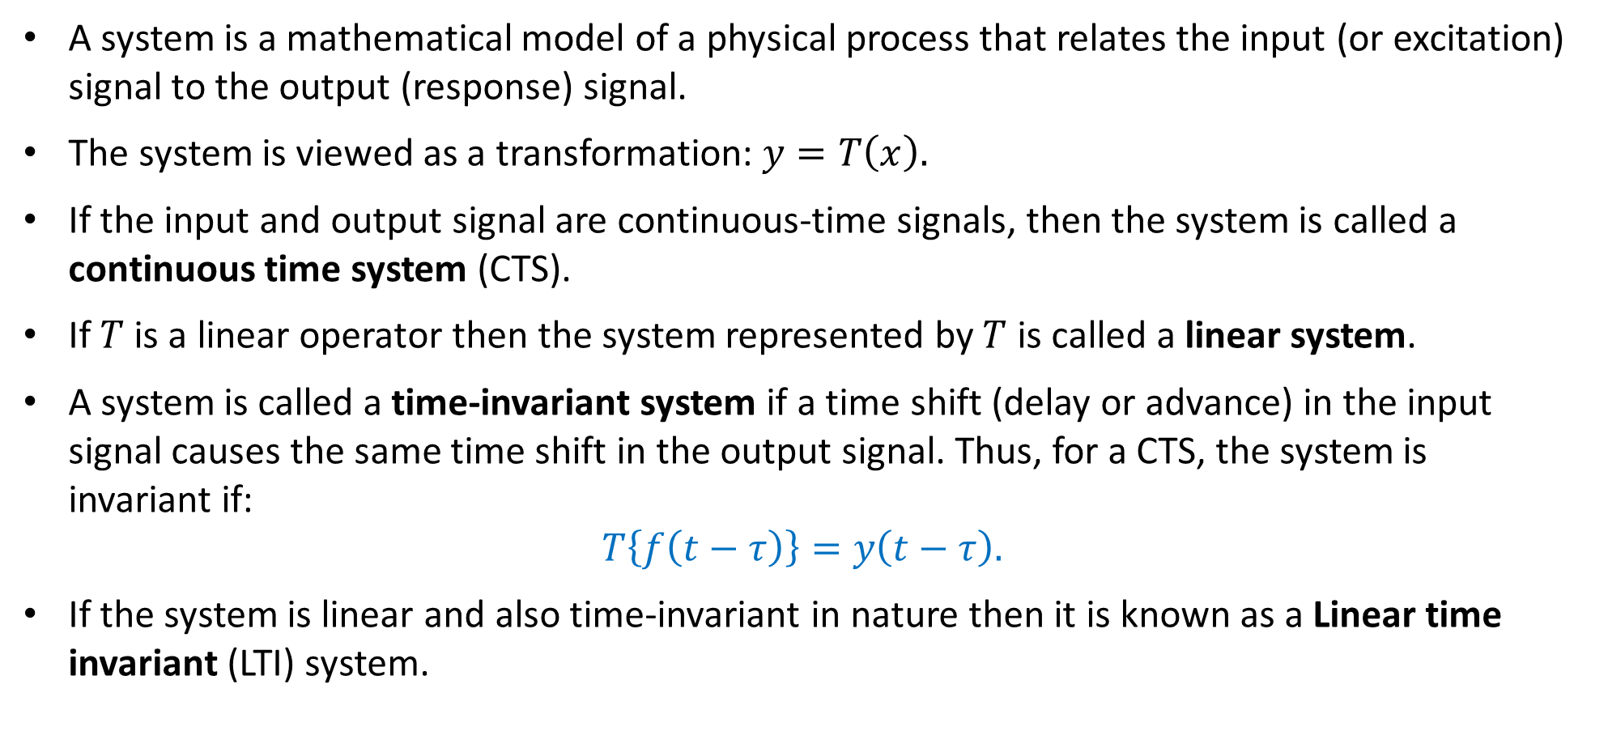
System representation and LTI Systems:
A system is a mathematical model of a physical process that relates the input (or excitation) signal to the output (response) signal.
The system is viewed as a transformation: $y=T\left(x\right).$
If the input and output signal are continuous-time signals, then the system is called a continuous time system (CTS).
If $T$ is a linear operator then the system represented by $T$ is called a linear system.
A system is called a time-invariant system if a time shift (delay or advance) in the input signal causes the same time shift in the output signal. Thus, for a CTS, the system is invariant if:
$T\left\{f\left(t−τ\right)\right\}=y\left(t−τ\right).$
If the system is linear and also time-invariant in nature then it is known as a Linear time invariant (LTI) system.

Slide 65
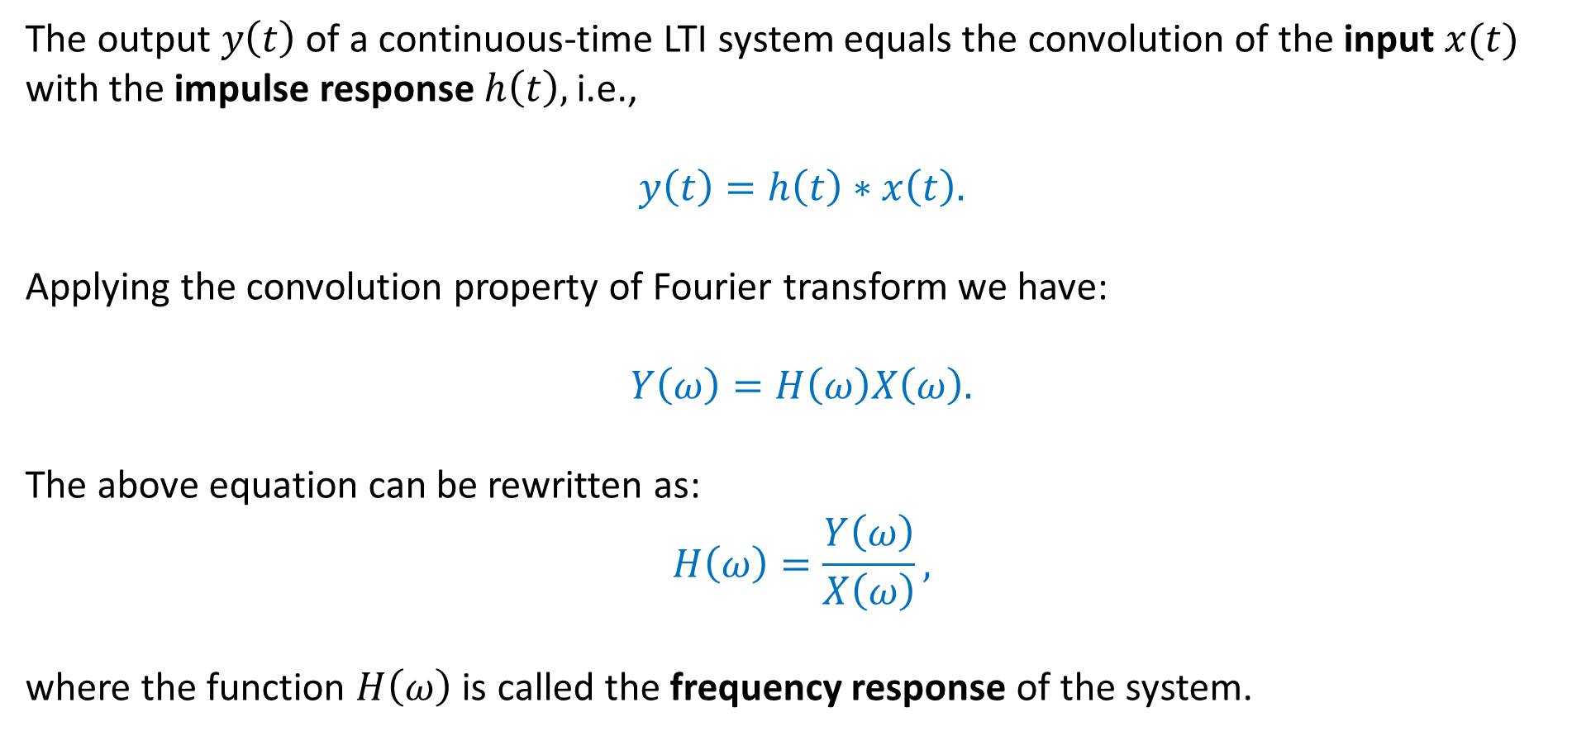
Frequency response of Continuous LTI Systems:
The output $y\left(t\right)$ of a continuous-time LTI system equals the convolution of the input $x(t)$ with the impulse response $h\left(t\right),$ i.e.,
$$y\left(t\right)=h\left(t\right)∗x\left(t\right).$$
Applying the convolution property of Fourier transform we have:
$Y\left(ω\right)=H\left(ω\right)X\left(ω\right).$
The above equation can be rewritten as:
$$H\left(ω\right)=\frac{Y\left(ω\right)}{X\left(ω\right)},$$
where the function $H\left(ω\right)$ is called the frequency response of the system.

Slide 68
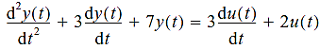
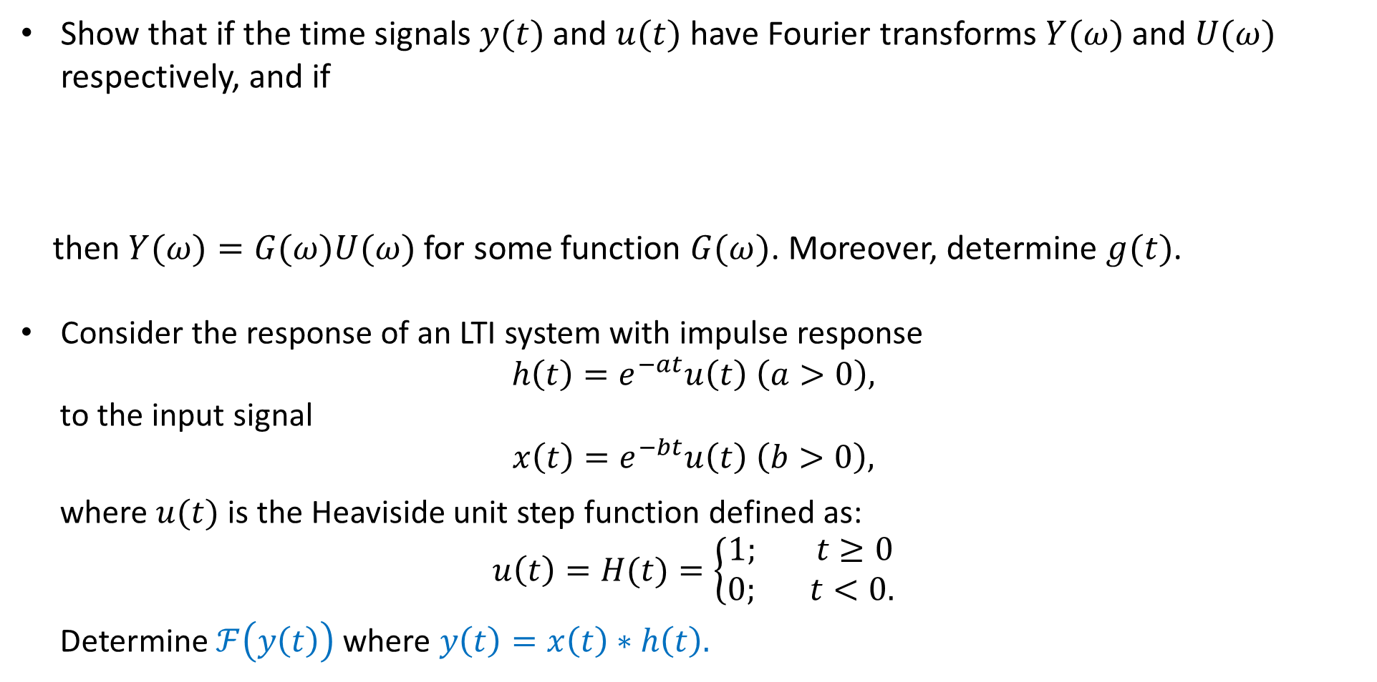
Examples:
Show that if the time signals $y(t)$ and $u(t)$ have Fourier transforms $Y(ω)$ and $U(ω)$
respectively, and if
then $Y(ω)=G(ω)U(ω)$for some function $G(ω)$. Moreover, determine $g(t)$.
Consider the response of an LTI system with impulse response
$$h\left(t\right)=e^{−at}u\left(t\right) \left(a>0\right),$$
to the input signal
$$x\left(t\right)=e^{−bt}u\left(t\right) \left(b>0\right),$$
where $u(t)$ is the Heaviside unit step function defined as:
$$u\left(t\right)=H(t)=\left\{\begin{aligned}1; t≥0 \\ \text{0}\text{;} t<0.\end{aligned}\right.$$
Determine $ℱ\left(y\left(t\right)\right)$ where $y\left(t\right)=x\left(t\right)∗h\left(t\right).$

Slide 69
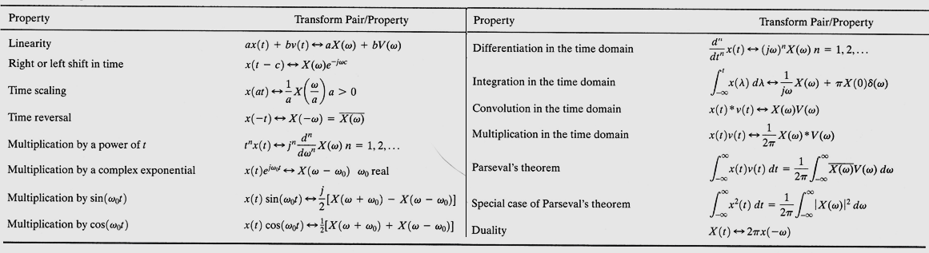
Properties of the Fourier Transform

Slide 70
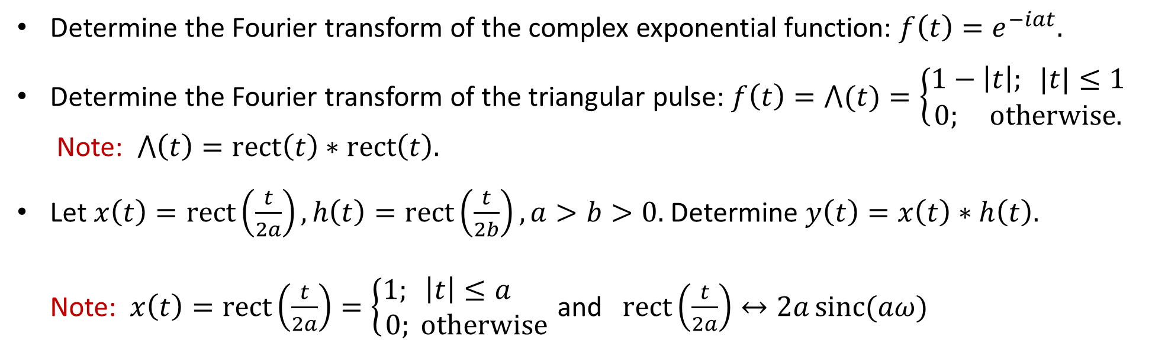
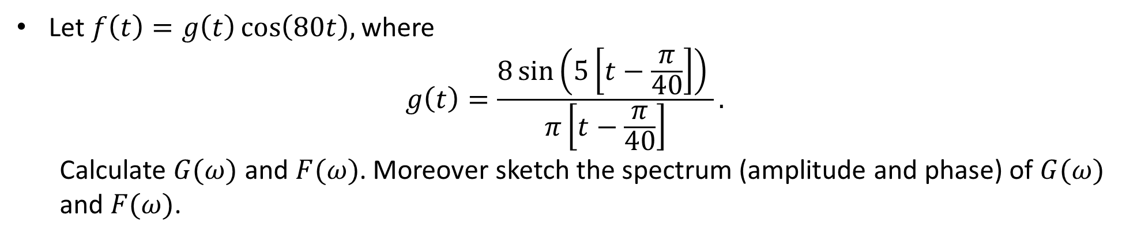
Practice Questions
Let $f\left(t\right)=g\left(t\right)\cos\left(80t\right),$ where
$$g\left(t\right)=\frac{8\sin\left(5\left[t−\frac{π}{40}\right]\right) }{π\left[t−\frac{π}{40}\right]}.$$
Calculate $G(ω)$ and $F(ω)$. Moreover sketch the spectrum (amplitude and phase) of $G(ω)$ and $F(ω)$.
Determine the Fourier transform of the complex exponential function: $f\left(t\right)=e^{−iat}.$
Determine the Fourier transform of the triangular pulse: $f\left(t\right)=⋀(t)=\left\{\begin{aligned}1−\left|t\right|; |t|≤1 \\ 0; otherwise.\end{aligned}\right.$
Note: $⋀\left(t\right)=rect\left(t\right)∗rect\left(t\right).$
Let $x\left(t\right)=rect\left(\frac{t}{2a}\right),h\left(t\right)=rect\left(\frac{t}{2b}\right), a>b>0.$ Determine $y\left(t\right)=x\left(t\right)∗h\left(t\right).$
Note: $x\left(t\right)=rect\left(\frac{t}{2a}\right)=\left\{\begin{aligned}1; \left|t\right|≤a \\ 0; otherwise\end{aligned}\right.$ and $rect\left(\frac{t}{2a}\right)↔2a\operatorname{sinc}{(aω)}$

Slide 71
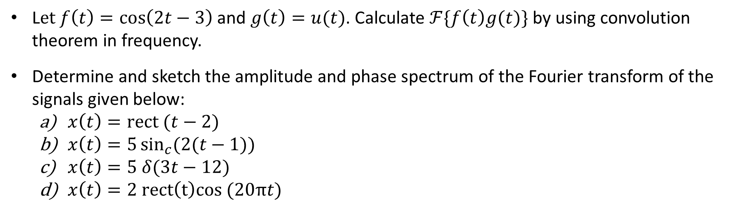

Practice Questions
A relaxed, causal LTI system is described by the following ODE:
$$y^{′′}\left(t\right)+3y^{′}\left(t\right)+2y\left(t\right)=x^{′}\left(t\right),$$
where $x(t)$ is the input and $y\left(t\right)$ represents the output. Using Fourier transform (FT)
techniques determine the output $y(t)$ when the input is $x\left(t\right)=u\left(t\right),$the unit step
function.
L$et$ $f\left(t\right)=\cos\left(2t−3\right)$ and $g\left(t\right)=u(t)$. Calculate $ℱ\{f\left(t\right)g(t)\}$ by using convolution theorem in frequency.
Determine and sketch the amplitude and phase spectrum of the Fourier transform of the signals given below:
$x\left(t\right)=rect (t−2)$
$x\left(t\right)=5\sin_{c}{(2(t−1))}$
$x\left(t\right)=5 δ(3t−12)$
$x\left(t\right)=2 rect\left(t\right)cos (20πt)$

Slide 72


Practice Questions
Show that: $δ\left(t−t_{1}\right)∗δ\left(t−t_{2}\right)=δ\left(t−\left(t_{1}+t_{2}\right)\right).$
Determine the inverse Fourier transforms of the following:
$F\left(ω\right)=\frac{e^{−iωτ}}{i(ω+ω_{0})}+π δ\left(ω+ω_{0}\right)e^{iω_{0}τ}.$
$F\left(ω\right)=\frac{e^{iωτ}}{i(ω−ω_{0})}+π δ\left(ω−ω_{0}\right)e^{iω_{0}τ}.$
Rectangular and triangular functions are shown in the figure:
Calculate $x\left(t\right)∗h\left(t\right).$

Slide 73

Energy and Power signals:
The Parseval's relation is defined as:
$$\int_{−∞}^{∞}{{|f(t)|}^{2}dt}=\frac{1}{2π}\int_{−∞}^{∞}{{|F(ω)|}^{2}dω.}$$
The term on the left-hand side of above is the total energy in the signal $f(t)$. Parseval's relation says that this total energy may be determined either by computing the energy per unit time $({|f(t)|}^{2})$ and integrating over all time or by computing the energy per unit frequency $({\left|F\left(ω\right)\right|}^{2}/2π)$ and integrating over all frequencies. For this reason, ${|F(ω)|}^{2}$ is often referred to as the energy-density spectrum of the signal $f(t)$.
The signals whose energy is finite are characterized as energy signals.

Slide 74

Energy and Power signals:
The signals whose energy is finite are characterized as energy signals, however there are signals with infinite energy (or the energy integral does not converge to a finite limit). We define the power of a signal as:
$$P=\lim_{T→∞}{\frac{1}{T}}\int_{−T/2}^{T/2}{{|f(t)|}^{2}dt}$$
The signals with infinite energy and finite average power are normally characterized as power signals.

